Slide 1
Superstore dataset

Slide 2
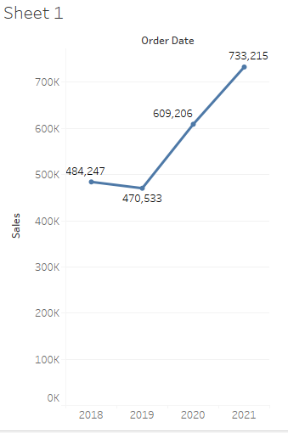
Find the sales for every year and find the highest sales and show the view in bar graph.
2018 - 4,84,247
2019 - 4,70,533
2020 - 6,09,206
2021 - 7,33,215

Slide 3
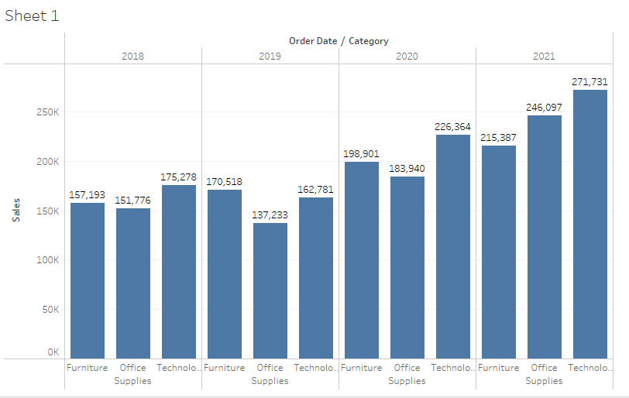
Category wise sales for every year.

Slide 4
Which category has highest sales in the year 2020 & 2021?
TECHNOLOGY
2020 - 2,26,364
2021 - 2,71,731

Slide 5
Based on the analysis of the year 2020 & 2021. give some suggestions to improve Sales in the year 2022
Based on 2020 and 2021 Technology has grown simuntinously, hence expected to grow in 2022 as well.
Based on 2020 and 2021 office sales have doubled up which repesents a good sign and same need to continue in 2022.
Company need to work more on the furniture sales as comparing the last two years sales the growth is less and the sale is also less compared to other products.

Slide 6
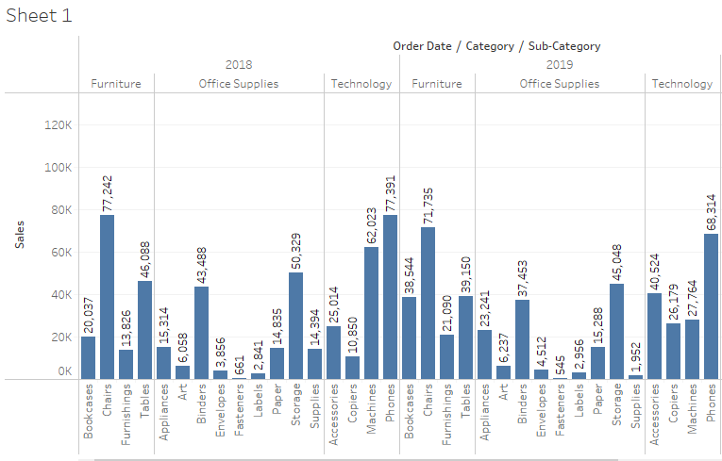
Display subcategory and find some insights from the view about max and min sales under every category.

Slide 7
